Slide 1

Data Structures (15B11CI311) Odd Semester 2022
3rd Semester , Computer Science and Engineering
Jaypee Institute Of Information Technology (JIIT), Noida

Slide 2
Lecture 2 – Introduction to Data Structures Outline
Data Structures
Discussion of Abstract data type
Need of Linear and Non-linear data structures using examples
Static and dynamic memory allocation
memory allocation for arrays and linked list

Slide 3
Data Structures
A data structure is a scheme for organizing data in the memory of a computer
The way in which the data is organized affects the performance of a program for different tasks
Every data structure has its own strengths, and weaknesses.
Also, every data structure specially suits to specific problem types depending upon the operations performed and the data organization.

Slide 4
Abstract data type
The Data Type is basically a type of data that can be used in different computer program such as integer, char, float etc.
The integer takes 4-bytes, character takes 1-byte of space etc.
The abstract data type is special kind of data type, whose behaviour is defined by
a set of values and
set of operations.
Why abstract?
How those operations are working that is totally hidden from the user (abstract)

Slide 5
ADT Examples
ADT examples: Stack, Queue, List etc.
ADT operations:
Stack operations −
isFull(): to check whether stack is full or not
isEmpty(): to check whether stack is empty or not
push(x): to push x into the stack
pop(): to delete one element from top of the stack
peek(): to get the top most element of the stack
size(): to get number of elements present into the stack

Slide 6
ADT Examples
Queue operations −
isFull(): to check whether queue is full or not
isEmpty(): to check whether queue is empty or not
insert(x): to add x into the queue at the rear end
delete(): to delete one element from the front end of the queue
size(): to get number of elements present into the queue

Slide 7
ADT Examples
List operations −
insert(x): to insert one element into the list
remove(x): to remove given element from the list
size(): to get number of elements present into the list
get(i): to get element at position i
replace(x, y):to replace x with y value

Slide 8
Need of Linear and Non-linear data structures using examples
Linear Data Structure:
data elements are arranged Linearly (sequentially)
The elements are attached to its previous and next adjacent
Only single level is involved.
Therefore, all the elements can be traversed in single run only.
easy to implement because computer memory is arranged in a linear way.
Examples: array, stack, queue, linked list, etc.

Slide 9
Need of Linear and Non-linear data structures using examples
Non-linear Data Structure
data elements are not arranged linearly.
single level is not involved.
All the elements can not be traversed in single run only.
not easy to implement in comparison to linear DS.
It utilizes computer memory efficiently in comparison to a linear data structure.
Examples: trees and graphs.

Slide 10
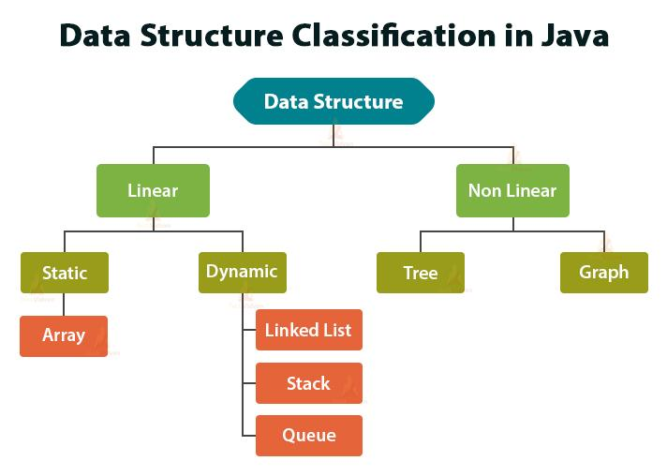
Linear and Non-linear data structures
Source: https://techvidvan.com/tutorials/data-structure-in-java/

Slide 11
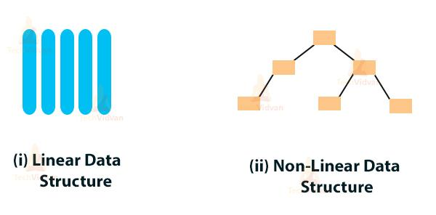
Source: https://techvidvan.com/tutorials/data-structure-in-java/

Slide 12
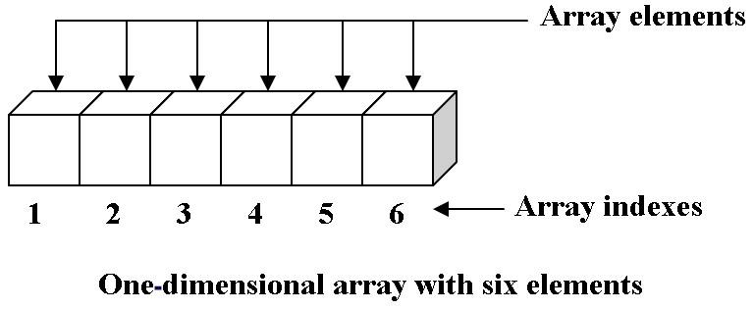
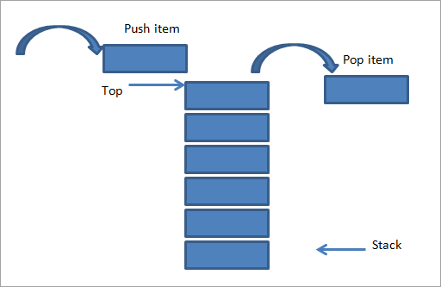
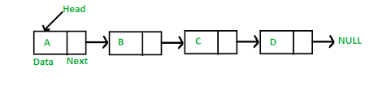
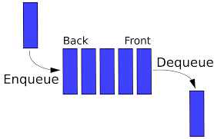
Source: http://123codegenerator.blogspot.com/2010/05/array-data-type.html
Source: https://www.softwaretestinghelp.com/stack-in-cpp/
Source: https://www.geeksforgeeks.org/data-structures/linked-list/
source: https://medium.com/@pleelaprasad/data-structures-3515827fbf89

Slide 13
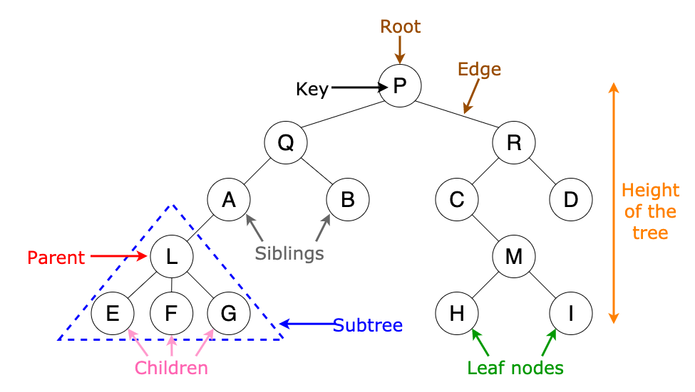
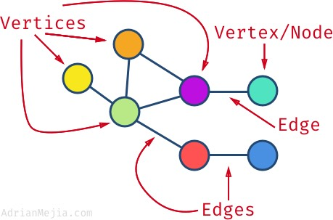
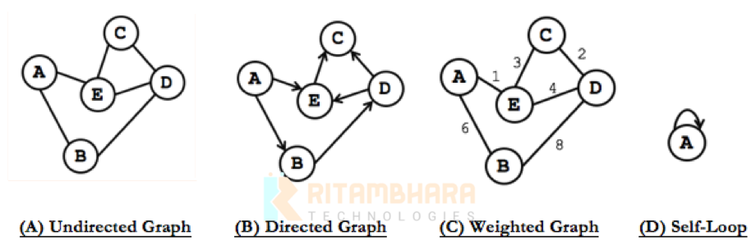
++++++++++++++++
Source: https://towardsdatascience.com/8-useful-tree-data-structures-worth-knowing-8532c7231e8c
Source: https://morioh.com/p/e9d17b46e8dd
Source: https://dzone.com/articles/an-overview-to-working-of-graphs-in-data-structure

Slide 14
Memory Allocation
Memory allocation in programming is very important for storing values when you assign them to variables
allocates memory for the variables declared by a programmer via the compiler
allocation is done either before or at the time of program execution

Slide 15
Ways for memory allocation
Compile time allocation or static allocation of memory:
The memory for named variables is allocated by the compiler.
The memory allocated by the compiler is allocated on the stack.
Exact size and storage must be known at compile time.
for array declaration, the size has to be constant.
Runtime allocation or dynamic allocation of memory:
The memory is allocated at runtime.
The memory space is allocated dynamically within the program run.
Dynamically allocated memory is allocated on the heap.
The exact space or number of the data items does not have to be known by the compiler in advance.
Pointers play a major role for dynamic memory allocation.

Slide 16
Dynamic Memory Allocation
Memory de-allocation is also an important part of this concept
The "clean-up" of storage space is done for variables or for other data storage.
It is the job of the programmer to de-allocate dynamically created space.
For de-allocating dynamic memory, delete operator is used.
In other words, dynamic memory Allocation refers to performing memory management for dynamic memory allocation manually.

Slide 17
Memory Parts in C++ Program
stack:
All variables declared inside any function takes up memory from the stack.
heap:
It is the unused memory of the program and can be used to dynamically allocate the memory at runtime.

Slide 18
The “new” Operator
To allocate space dynamically, unary operator new is used , followed by the type being allocated for memory.
new int; //dynamically allocates memory for an integer type
new double; // dynamically allocates memory an double type
new int[30]; // dynamically allocates memory for integer array

Slide 19
Allocating space for new
int * ptr=NULL; // declares a pointer ptr
ptr = new int; // dynamically allocate an int for loading the address in ptr
double * i; // declares a pointer i
i = new double; // dynamically allocate a double and loading the address in i
In the above example,
we have declared a pointer variable ‘ptr’ to integer and initialized it to null.
Using the “new” operator memory will be allocate to the “ptr” variable.

Slide 20
Dynamic Memory Allocation for Arrays
To allocate memory for an array of characters, i.e., a string of 50 characters. Using that same syntax, memory can be allocated dynamically
char* str = NULL; // Pointer initialized with NULL
str= new char[50]; // Dynamic Allocation will be done
Here, new operator allocates 50 continuous elements of type characters to the pointer variable str and returns the pointer to the first element of str.

Slide 21
Dynamic Memory Allocation for Linked List
Let us take a structure of a linked list node:
struct node
{
int data;
node *next;
};
node *temp=new node; // dynamic memory allocation
Memory is allocated required for a node by the new operator.
‘temp’ points to a node (or space allocated for the node).

Slide 22
Example: Linked List using new operator
#include <iostream>
using namespace std;
struct node
{
int data;
node *next;
};
class linked_list
{
private:
node *head,*tail;
public:
linked_list()
{
head = NULL;
tail = NULL;
}
void add_node(int n)
{
node *tmp = new node;
tmp->data = n;
tmp->next = NULL;
if(head == NULL)
{
head = tmp;
tail = tmp;
}
else
{
tail->next = tmp;
tail = tail->next;
}
}
};
int main()
{
linked_list a;
a.add_node(1);
a.add_node(2);
return 0;
}
Source: https://www.codesdope.com/blog/article/c-linked-lists-in-c-singly-linked-list/

Slide 23
The Delete Operator
The memory allocated dynamically using the new operator has to be freed explicitly by the programmer. For this purpose, the “delete” operator is used
The general syntax of the delete operator is:
delete pointer_variable;
So memory allocated to the ptr variable can be freed as:
delete ptr;
This statement frees the memory allocated to the variable “ptr” back to the memory pool.
delete operator can also be used to free the memory allocated to arrays.

Slide 24
The Delete Operator
the memory allocated to the array str above can be freed as follows:
delete[] str;
Note the subscript operator used with the delete operator.
This is because, as we have allocated the array of elements, we need to free all the locations.
Instead, if the following statement had executed:
delete str;
the above statement will only delete the first element of the array.
Using subscript “[]” all the memory allocated is to be freed.

Slide 25
Malloc()
The malloc() function from C, also exists in C++,
But it is recommended to avoid using malloc() function.
malloc() allocates requested size of bytes and returns a pointer to the first byte of allocated space.
The main benefit of new over malloc() is that new doesn't just allocate memory, it constructs objects which is a prime concept of C++.

Slide 26
Dynamic memory allocation Programming Example:1
#include <iostream>
using namespace std;
int main()
{
int* i= NULL;
i= new int;
*i= 5;
cout << "Value is : " << *i<< endl; delete val;
}

Slide 27
Example 2 : new and delete operators in C++.
#include <iostream> #include <string> using namespace std; int main() { int *p= NULL; i= new int(); int *a= new int(10); if(!p) { cout<<"bad memory allocation"<<endl; } else { cout<<"memory allocated successfully"<<endl; *p= 5; cout<<"*p= "<<*p<<endl; cout<<"*a= "<<*a<<endl; }
double *arr= NULL; arr= new double[10]; if(!arr) {cout<<"memory not allocated"<<endl;} else { for(int i=0;i<5;i++) arr] = i+1; cout<<“Array values : "; for(int i=0;i<5;i++) cout<<arr[i]<<"\t"; } delete p; delete a; delete[] arr; return 0;

Slide 28
Program Output
memory allocated successfully *i= 5 *a= 10 Array values:1 2 3 4 5

Slide 29
The major differences between static and dynamic memory allocations
Static Memory Allocation | Dynamic Memory Allocation
Memory Allocates variables permanently | Memory Allocates variables only if program unit gets active
Memory Allocation is done before program execution | Memory Allocation is done during program execution
Use stack data structure for implementation | Use heap data structure for implementation
Less efficient | More efficient
no Memory reusable | memory reusable and can be freed when not required
https://www.w3schools.in/difference-in-static-and-dynamic-memory-allocation/

Slide 30
References
Robert Lafore, Object Oriented Programming in C++, SAMS, 2002
https://www.softwaretestinghelp.com/new-delete-operators-in-cpp/
https://www.softwaretestinghelp.com/stack-in-cpp/
https://www.geeksforgeeks.org/
https://www.tutorialspoint.com/abstract-data-type-in-data-structures

